Slide 1
Mobile IP and Wireless Application Protocol
Chapter 7

Slide 2
Mobile IP

Slide 3
Mobile IP Uses
Enable computers to maintain Internet connectivity while moving from one Internet attachment point to another
Mobile – user's point of attachment changes dynamically and all connections are automatically maintained despite the change

Slide 4
Operation of Mobile IP
Mobil node is assigned to a particular network – home network
IP address on home network is static – home address
Mobile node can move to another network – foreign network
Mobile node registers with network node on foreign network – foreign agent
Mobile node gives care-of address to agent on home network – home agent

Slide 5
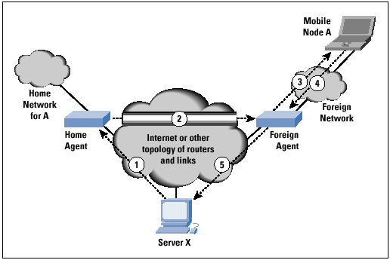
Mobile IP Scenario

Slide 6
Mobile IP Scenario (see figure)
Server X transmits an IP datagram destined for mobile node A.
At the home network, the IP datagram is intercepted by the home agent, who encapsulates the datagram inside a new IP datagram that has the A’s care-of address in the header and retransmits the datagram. (known as Tunneling)
The foreign agent strips off the outer IP header, and delivers the original datagram to A across the foreign network.
When A sends IP traffic to X, it uses X’s IP address.
The IP datagram from A to X travels directly to X.

Slide 7
Capabilities of Mobile IP
Discovery – mobile node uses discovery procedure to identify prospective home and foreign agents
Registration – mobile node uses an authenticated registration procedure to inform home agent of its care-of address
Tunneling – used to forward IP datagrams from a home address to a care-of address

Slide 8
Discovery
Mobile node is responsible for ongoing discovery process
  Must determine if it is attached to its home network or a foreign network
Transition from home network to foreign network can occur at any time without notification to the network layer
Mobile node listens for agent advertisement messages
  Compares network portion of the router's IP address with the network portion of home address

Slide 9
Agent Solicitation
Foreign agents are expected to issue agent advertisement messages periodically
If a mobile node needs agent information immediately, it can issue ICMP router solicitation message
  Any agent receiving this message will then issue an agent advertisement

Slide 10
Move Detection
Mobile node may move from one network to another due to some handoff mechanism without IP level being aware
  Agent discovery process is intended to enable the agent to detect such a move
Algorithms to detect move:
  Use of lifetime field – mobile node uses lifetime field as a timer for agent advertisements
  Use of network prefix – mobile node checks if any newly received agent advertisement messages are on the same network as the node's current care-of address

Slide 11
Co-Located Addresses
If mobile node moves to a network that has no foreign agents, or all foreign agents are busy, it can act as its own foreign agent
Mobile agent uses co-located care-of address
  IP address obtained by mobile node associated with mobile node's current network interface
Means to acquire co-located address:
  Temporary IP address through an Internet service, such as DHCP
  May be owned by the mobile node as a long-term address for use while visiting a given foreign network

Slide 12
Registration Process
Mobile node sends registration request to foreign agent requesting forwarding service
Foreign agent relays request to home agent
Home agent accepts or denies request and sends registration reply to foreign agent
Foreign agent relays reply to mobile node

Slide 13
Registration Operation Messages
Registration request message
  Fields = type, S, B, D, M, V, G, lifetime, home address, home agent, care-of-address, identification, extensions
Registration reply message
  Fields = type, code, lifetime, home address, home agent, identification, extensions

Slide 14
Registration Procedure Security
Mobile IP designed to resist attacks
  Node pretending to be a foreign agent sends registration request to a home agent to divert mobile node traffic to itself
  Agent replays old registration messages to cut mobile node from network
For message authentication, registration request and reply contain authentication extension
  Fields = type, length, security parameter index (SPI), authenticator

Slide 15
Types of Authentication Extensions
Mobile-home – provides for authentication of registration messages between mobile node and home agent; must be present
Mobile-foreign – may be present when a security association exists between mobile node and foreign agent
Foreign-home – may be present when a security association exists between foreign agent and home agent

Slide 16
Tunneling
Home agent intercepts IP datagrams sent to mobile node's home address
  Home agent informs other nodes on home network that datagrams to mobile node should be delivered to home agent
Datagrams forwarded to care-of address via tunneling
  Datagram encapsulated in outer IP datagram

Slide 17
Mobile IP Encapsulation Options
IP-within-IP – entire IP datagram becomes payload in new IP datagram
  Original, inner IP header unchanged except TTL decremented by 1
  Outer header is a full IP header
Minimal encapsulation – new header is inserted between original IP header and original IP payload
  Original IP header modified to form new outer IP header
Generic routing encapsulation (GRE) – developed prior to development of Mobile IP
Notes:
Generic Routing Encapsulation (GRE) is a tunneling protocol developed by Cisco Systems that can encapsulate a wide variety of network layer protocols inside virtual point-to-point links over an Internet Protocol internetwork.

Slide 18
Use of Mobile IP
Mobile IP is most often found in wired and wireless environments where users need to carry their mobile devices across multiple LAN subnets. Examples of use are in roaming between overlapping wireless systems, e.g., IP over DVB, WLAN, WiMAX and BWA (broadband wireless access)
Mobile IP is not required within cellular systems such as 3G, to provide transparency when Internet users migrate between cellular towers, since these systems provide their own data link layer handover and roaming mechanisms.

Slide 19
Wireless Application Protocol (WAP)

Slide 20
Wireless Application Protocol (WAP)
Open standard providing mobile users of wireless terminals access to telephony and information services
  Wireless terminals include wireless phones, pagers and personal digital assistants (PDAs)
  Designed to work with all wireless network technologies such as GSM, CDMA, and TDMA
  Based on existing Internet standards such as IP, XML, HTML, and HTTP
  Includes security facilities

Slide 21
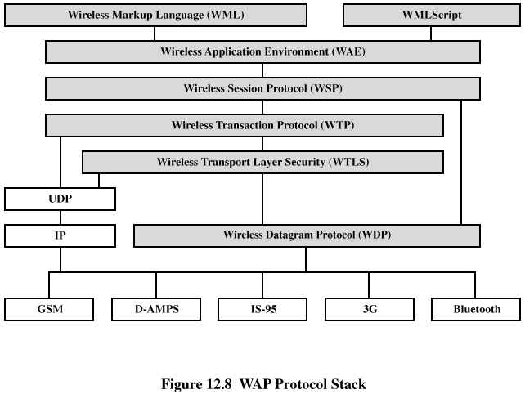
WAP Protocol Stack

Slide 22
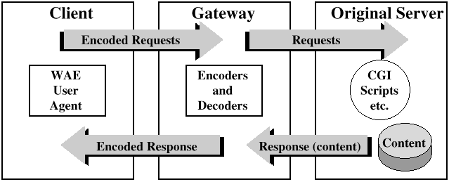
WAP Programming Model

Slide 23
Wireless Markup Language (WML) Features
Text and image support – formatting and layout commands
Deck/card organizational metaphor – WML documents subdivided into cards, which specify one or more units of interaction
Support for navigation among cards and decks – includes provisions for event handling; used for navigation or executing scripts

Slide 24
WMLScript
Scripting language for defining script-type programs in a user device with limited processing power and memory
WMLScript capabilities:
  Check validity of user input before it’s sent
  Access device facilities and peripherals
  Interact with user without introducing round trips to origin server

Slide 25
WMLScript
WMLScript features:
  JavaScript-based scripting language
  Procedural logic
  Event-based
  Compiled implementation
  Integrated into WAE

Slide 26
Wireless Application Environment (WAE)
WAE specifies an application framework for wireless devices
WAE elements:
  WAE User agents – software that executes in the wireless device
  Content generators – applications that produce standard content formats in response to requests from user agents in the mobile terminal
  Standard content encoding – defined to allow a WAE user agent to navigate Web content
  Wireless telephony applications (WTA) – collection of telephony-specific extensions for call and feature control mechanisms

Slide 27
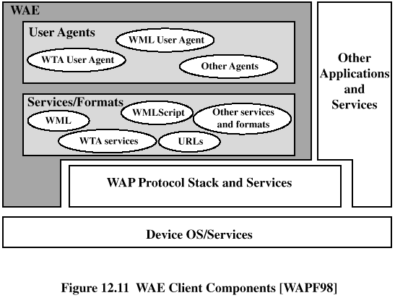
WAE Client Components

Slide 28
Wireless Session Protocol (WSP)
Transaction-oriented protocol based on the concept of a request and a reply
Provides applications with interface for two session services:
  Connection-oriented session service – operates above reliable transport protocol WTP
  Connectionless session service – operates above unreliable transport protocol WDP

Slide 29
Wireless Transaction Protocol (WTP)
Lightweight protocol suitable for "thin" clients and over low-bandwidth wireless links
WTP features
  Three classes of transaction service
  Optional user-to-user reliability: WTP user triggers confirmation of each received message
  Optional out-of-band data on acknowledgments
  PDU concatenation and delayed acknowledgment to reduce the number of messages sent
  Asynchronous transactions

Slide 30
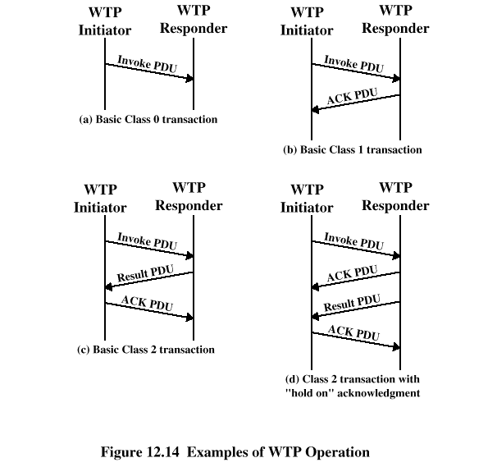
Examples of WTP Operation

Slide 31
WTP PDU Types
Invoke PDU – used to convey a request from an initiator to a responder
ACK PDU – used to acknowledge an Invoke or Result PDU
Result PDU – used to convey response of the server to the client
Abort PDU – used to abort a transaction
Segmented invoke PDU and segmented result PDU – used for segmentation and reassembly
Negative acknowledgment PDU – used to indicate that some packets did not arrive

Slide 32
Wireless Datagram Protocol (WDP)
Used to adapt higher-layer WAP protocol to the communication mechanism used between mobile node and WAP gateway
WDP hides details of the various bearer networks from the other layers of WAP
Adaptation may include:
  Partitioning data into segments of appropriate size for the bearer
  Interfacing with the bearer network

